Slide 1
Bluetooth

Slide 2

Introduction
Bluetooth is a standardized protocol for sending and receiving data via a 2.4GHz wireless link.
It’s a secure protocol, and it’s perfect for short-range, low-power, low-cost, wireless transmissions between electronic devices.

Slide 3
Introduction
These days it feels like everything is wireless, and Bluetooth is a big part of that wireless revolution.
You’ll find Bluetooth embedded into a great variety of consumer products, like headsets, video gamecontrollers
In our world of embedded electronics hackery, Bluetooth serves as an excellent protocol for wirelessly transmitting relatively small amounts of data over a short range (<100m).
It’s perfectly suited as a wireless replacement for serial communication interfaces.

Slide 4
HOW BLUETOOTH WORKS
The Bluetooth protocol operates at 2.4GHz in the same unlicensed ISM frequency band where RF protocols like ZigBee and WiFi also exist.

Slide 5
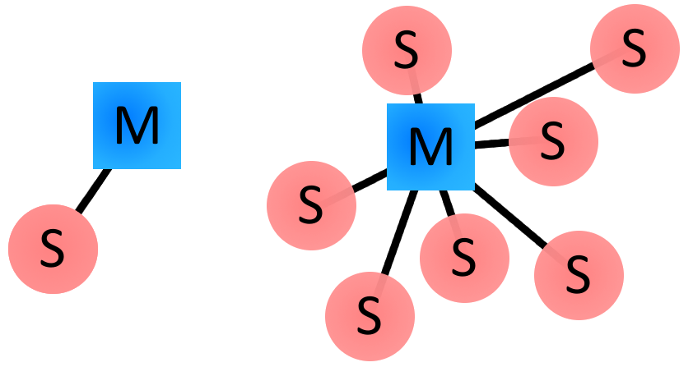
Masters, Slaves, and Piconets
Bluetooth networks (commonly referred to as piconets) use a master/slave model to control when and where devices can send data.
In this model, a single master device can be connected to up to seven different slave devices. Any slave device in the piconet can only be connected to a single master.

Slide 6
Masters, Slaves, and Piconets
The master coordinates communication throughout the piconet. It can send data to any of its slaves and request data from them as well.
Slaves are only allowed to transmit to and receive from their master. They can’t talk to other slaves in the piconet.
Bluetooth Addresses and Names
Every single Bluetooth device has a unique 48-bit address, commonly abbreviated BD_ADDR.
This will usually be presented in the form of a 12-digit hexadecimal value.
The most-significant half (24 bits) of the address is an organization unique identifier (OUI), which identifies the manufacturer. The lower 24-bits are the more unique part of the address.

Slide 7
ARDUINO WITH BLUETOOTH
HC-05

Slide 8
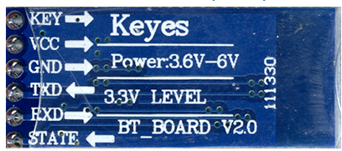
PIN CONFIGURATION
KEY/EN: If brought HIGH before power is applied, forces AT Command Setup Mode. LED blinks slowly (2 seconds)
VCC: +5 Power
GND: System / Arduino Ground
TXD: Transmit Serial Data from HC-05 to Arduino Serial Receive. NOTE: 3.3V HIGH level: OK for Arduino
RXD: Receive Serial Data from Arduino Serial Transmit
STATE: Tells if connected or not

Slide 9
COMMAND and DATA TRANSFER MODES:
The module has two modes of operation
Command Mode where we can send AT commands to it(LED blinks slowly, once in 2 seconds)
Data Mode where it transmits and receives data to another bluetooth module(Rapid LED blink)
Default: Data Mode

Slide 10
Default Settings
Baud Rate: 9600 bps
Passkey: 1234
Device Name: HC-05

Slide 11
Connection with Arduino
HC-05 -> Arduino
——————————-
vcc -> +5V
GND -> GND
EN ->+5V
TX ->10(SoftwareSerial RX)
RX ->11(SoftwareSerial TX)

Slide 12
COMMAND MODE
1. Unplug power(5V connection) from HC-05
2. Hold in HC-05 button
3. Reconnect power to HC-05 (wait until LED blinks slowly)
4. Upload code in arduino
4. Open Serial Monitor
5. Make sure "Both NL & CR" is selected
8. Type AT commands

Slide 13
AT Commands
AT (AT Test command. Should respond with OK)
AT+VERSION? (show the firmware version)
AT+UART=9600,0,0 (Set baud rate to 9600, 1 stop bit, no parity)
AT+ADDR?

Slide 14
TO ENTER DATA MODE
REMOVE EN CONNECTION
REMOVE POWER FROM HC-05
RECONNECT POWER
LED should blink rapidly indicating that it is ready to be paired with any other bluetooth device.

Slide 15
SLAVE CONFIGURATION
AT
AT+PSWD=1234
AT+PSWD?
AT+ROLE?
AT+ROLE=0
AT+ADDR?
—-Note down this, use comma in space of colon
Now remove the KEY connection from the HC05 module & disconnect the power.
Again provide the power to see STATUS LED on the module blinking fast indicating that it is looking for a PAIR.

Slide 16
MASTER CONFIGURATION
AT+ORGL
AT+RMAAD will release the module from any previous PAIR.
AT+PSWD=1234 to set the password as 1234
AT+ROLE=1 changes the ROLE of the module to MASTER
AT+CMODE=1
Allows connecting to any address.
Default is CMODE = 0 which allows connection to only bound address.
AT+INIT
AT+LINK=<address>

Slide 17
Pin Configuration – AT Command
HC-05 GND — Arduino GND Pin HC-05 VCC (5V) — Arduino 5V HC-05 TX — Arduino Pin 10 (soft RX) HC-05 RX — Arduino Pin11 (soft TX) HC-05 Key (PIN 34) — Arduino Pin 9

Slide 18
#include <SoftwareSerial.h>
SoftwareSerial BTSerial(2, 3); // RX | TX
void setup()
{
pinMode(9, OUTPUT); // this pin will pull the HC-05 pin 34 (key pin) HIGH to switch module to AT mode
digitalWrite(9, HIGH);
Serial.begin(9600);
Serial.println("Enter AT commands:");
BTSerial.begin(38400); // HC-05 default speed in AT command more
}
void loop()
{
// Keep reading from HC-05 and send to Arduino Serial Monitor
if (BTSerial.available())
Serial.write(BTSerial.read());
// Keep reading from Arduino Serial Monitor and send to HC-05
if (Serial.available())
BTSerial.write(Serial.read());
}

Slide 19
Bluetooth – AT Mode { Steps to change data mode to AT mode}
Unplug power from HC-05
Upload sketch
Hold in HC-05 button
Reconnect power to HC-05 (wait until LED blinks slowly)
Press Arduino reset button
Open Serial Monitor
Make sure “Both NL & CR” is selected
Type AT commands

Slide 20
AT Commands
AT – Check the Connection
AT+NAME – Default name
AT+ADDR – Default Address
AT+VERSION – Version
AT+UART – Baudrate
AT+ROLE – Role of the BT module (1=Master, 0=Slave)
AT+PSWD –Default password
AT+CMODE – Connection Mode { 0- connect to specific addr, 1- connect o any addr}
AT+ORGL – Restore factory settings
AT+RESET - Reset and exit AT mode

Slide 21
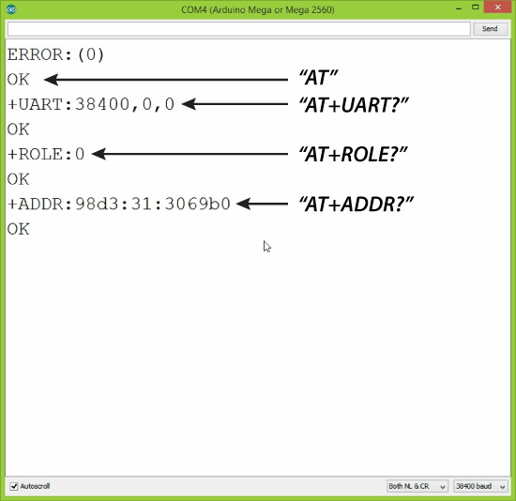
Slave Configuration

Slide 22
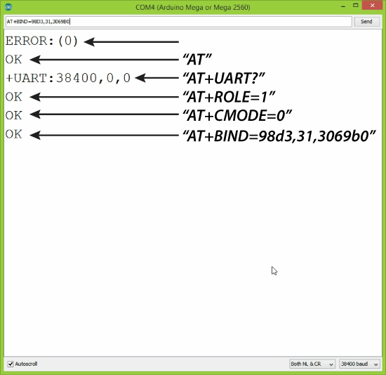
Master Configuration

Slide 23
Program to control the LED in the Master device by client device through push button through Bluetooth communication

Slide 24
Client Code
#include <SoftwareSerial.h>
SoftwareSerial BT(2,3);
#define button 8
int state = 20;
int buttonState = 0;
void setup() {
pinMode(button, INPUT);
BT.begin(38400);
Serial.begin(9600);
Serial.println("Slave Bluetooth");
}
void loop() {
// Reading the button
buttonState = digitalRead(button);
if (buttonState == HIGH) {
Serial.println("Sending...");
BT.write('1');// Sends '1' to the master to turn on LED
delay(200);
}
else {
BT.write('0');
delay(200);
}
}

Slide 25
#include<SoftwareSerial.h>
SoftwareSerial BTM(2,3);
#define ledPin 10
int state = 0;
void setup()
{
pinMode(ledPin, OUTPUT);
digitalWrite(ledPin, LOW);
BTM.begin(38400);
Serial.begin(9600);
Serial.println("Receiving Master");
// Default communication rate of the Bluetooth module
}
void loop() {
if(BTM.available() > 0){
state = BTM.read();
Serial.println("State of Slave");
Serial.println(state);
// Reads the data from the serial port
}
// Controlling the LED
if (state == '1') {
digitalWrite(ledPin, HIGH); // LED ON
delay(500);
}
else if (state == '0') {
digitalWrite(ledPin, LOW); // LED ON
}
delay(10);
}
Server Code

